Slide 1
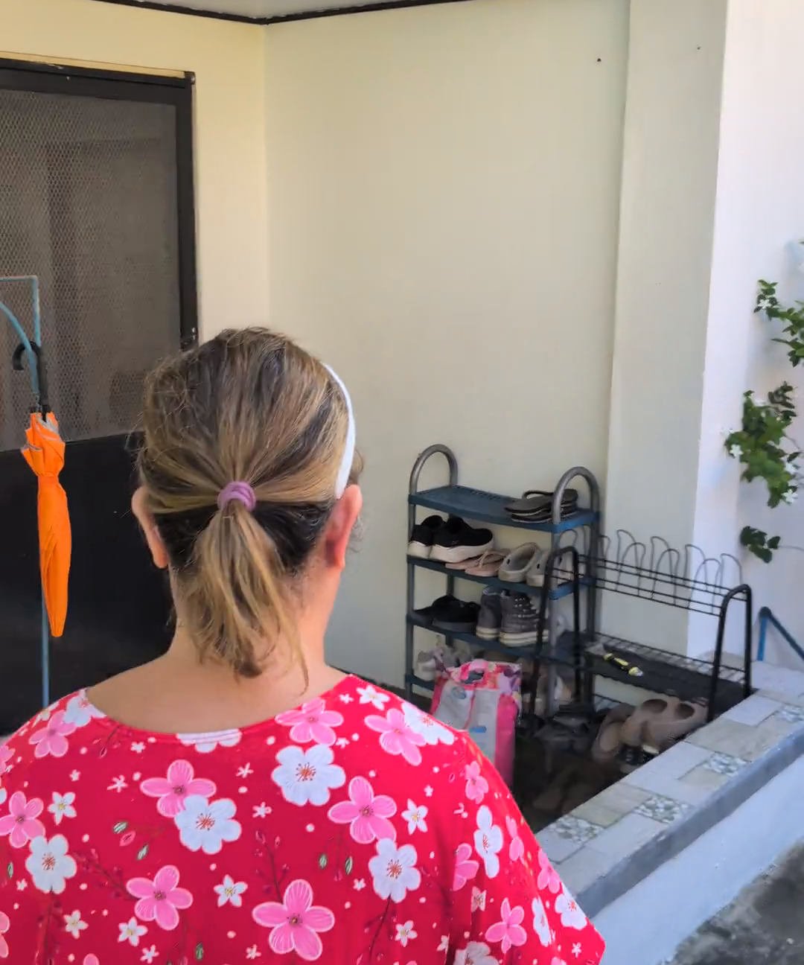
Past midnight.
Still answering
inquiries.
Notes:
Ina's Place is one of the owners we onboarded in Kubo. She's busy, she's old, so she needed help acquiring tenants for her extra, humble rooms. She told that it's very tiring posting, and answering inquiries over and over again, that it sometimes takes past midnight. After all that effort, some conversations end without a booking—or even a thank-you.
Owner account paraphrased by the founder; not a verbatim quotation. Video frame at 00:14.5: https://kubo.community/dorms/ina-s-place
https://media.kubo.community/dorms/c455d902-12bf-442a-936e-6888f074a1e3/tours/ina-place-tour-e4b4921c27bf.mp4

Slide 2
Providing a home
carries worries,
too.
Notes:
Yes, there are apparent problems that the students are clearly facing, but the owners, they're facing problems too. Because, yes, finding housing is an emotional decision, but providing one carries its own worries, too. And owners like her need someone who understands those worries—and practical help with what comes next.
Room photo: https://kubo.community/dorms/ina-s-place
https://media.kubo.community/dorms/c455d902-12bf-442a-936e-6888f074a1e3/room-images/8b3880d5-a05e-412d-a7f8-3b687e4bf9bf.webp

Slide 3
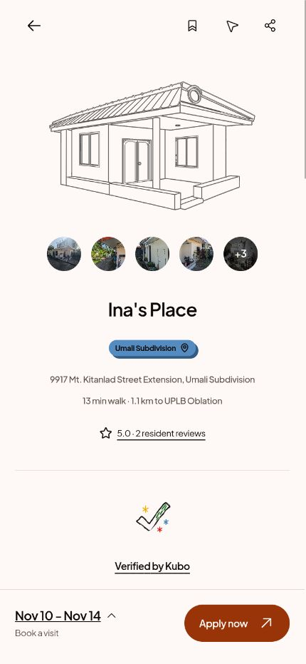
That’s where
Kubo comes in.
https://kubo.community
Notes:
And that’s where Kubo comes in.
We help rental owners like her show what they offer—the rooms, the rates, the rules, and the home they’ve worked hard to care for.
Through clear listings and video tours, students can understand the property before starting a conversation. When they’re ready, they can request a viewing or apply, with tools that help owners manage those next steps.
Actual public mobile-web screenshot captured November 8, 2026: https://kubo.community/dorms/ina-s-place

Slide 4
40
minutes
Notes:
In our early pilot, we saw students request viewings without even sending inquiries. One already applied for admission that came within forty minutes of the property post.
It’s small proof, but it gives us something to build on: helping owners spend less time explaining, and helping students arrive better informed.
Source: founder's first-hand pilot account in this conversation. Early application signal, not a confirmed rental, collected fee, measured time saving, or typical conversion result. No assumption that the pilot property was Ina’s Place. Repository reference: docs/research/2026-10-26-owner-messaging-briefs.md, Pilot observations.

Slide 5
25%
of the first month’s rent.
Once.
Notes:
Kubo earns a one-time fee of twenty-five percent of the first month’s agreed rent for a successful Kubo-acquired rental. Students use it free.
Source: docs/business/pricing.md. Standard only. One fee per successful rental under the written agreement. A whole-room rental is one fee on agreed room rent, irrespective of occupant count. No monthly or renewal fee. An inquiry, application, or visit alone is not a successful rental.

Slide 6
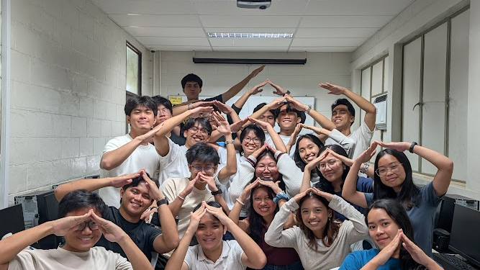

Open your doors
with confidence.
Notes:
We’re starting around UPLB—with people like the owner of Ina’s Place.
Because behind every listing is someone opening their doors.
We’re Kubo. And we help them open those doors with confidence.
Approved slogan: docs/marketing/brand-messaging.md. Team photo: apps/web/src/lib/assets/kubo-team.jpg, same original photo embedded on page 1 of output/pdf/[Kubo] Services Tester Brief.pdf. Cover-style photographic background, dark shading, white headline adapted to 16:9. Logo: apps/mobile/assets/images/kubo-brand-logo.png.

